Slide 1
Latest advancements in UI developments for interactive methods
Giomara Lárraga Faculty of Information Technology, University of Jyväskylä, Finland DESDEO Forum Future of Interactive Multiobjective Optimization
Multiobjective Optimization Group
DESDEO
June 19-20, 2023
Notes:
Change slide numbers

Slide 2
Content
Motivation
Introduction
Iterative design process
GUIs in DESDEO
Future developments

Slide 3
Motivation
We aim to develop intuitive and easy-to-use GUIs
that can be adopted by multiple methods​
Such interfaces should enable the DM to utilize the full strength of interactive methods efficiently and easily without requiring too much cognitive load

Slide 4
Introduction

Slide 5
Introduction
What is a User Interface (UI)?
Is the means by which a user interacts with a computer system, software application, or electronic device.
Different applications need different UIs
Types of user interfaces:
Command line
Form based
Menu-driven
Graphical User Interface (GUI)
Natural language interfaces

Slide 6
GUIs for Interactive Methods
Only a few user-friendly software implementations of interactive methods are available.
It is desirable that the GUIs for interactive methods have the following characteristics:
Intuitive: the steps to follow are clear for the DM in the entire solution process
Clear: all UI elements have a clear purpose
Reliable: information presented to the DM to be correct
Adaptable: different visualization types are utilized in the UI according to the needs of the method and the DM’s preferences
Notes:
Refer to the first talk. Say that they must be interactive

Slide 7
Visualizations to support DMs
Data visualization helps people analyze data quickly and efficiently
Good visualization enables visual exploration of the problem
Visualizations are not intended only to display data but also to retrieve information from the DM
Visualizations should be interactive, allowing the DM to:
→ Compare solutions​
→ Update preference information​
→ Select preferred solutions
Notes:
Say examples of information of the DM

Slide 8
UIs developed in our research group
2000:WWW-NIMBUS
2006: IND-NIMBUS
2019: Nonconvex Pareto Navigator
2019: NAUTILUS Navigator
Miettinen, K. and Mäkelä, M. M., Interactive Multiobjective Optimization System WWW-NIMBUS on the Internet, Computers & Operations Research, Vol. 27 (7-8), pp. 709-723, 2000.
Miettinen, K., IND-NIMBUS for Demanding Interactive Multiobjective Optimization, Trzaskalik, T.(ed.), Multiple Criteria Decision Making '05, , pp. 137-150, 2006.
Hartikainen, M., Miettinen, K., & Klamroth, K. (2019). Interactive Nonconvex Pareto Navigator for Multiobjective Optimization. European Journal of Operational Research, 275(1), 238-251..
Ruiz, A. B., Ruiz, F., Miettinen, K., Delgado-Antequera, L., & Ojalehto, V. (2019). NAUTILUS Navigator : free search interactive multiobjective optimization without trading-off. Journal of Global Optimization, 74 (2), 213-231.

Slide 9
Iterative design process

Slide 10
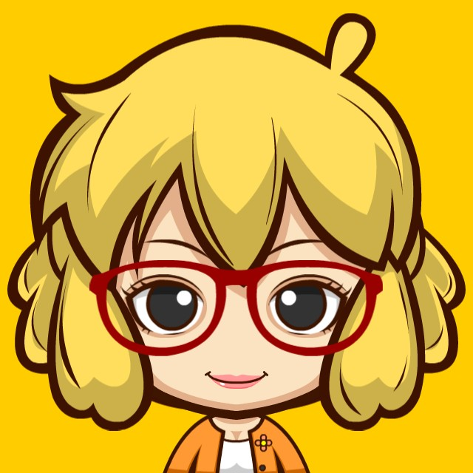
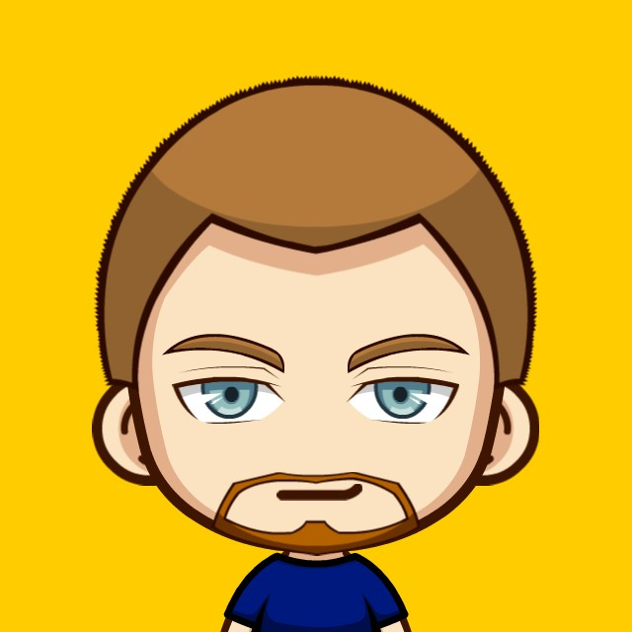
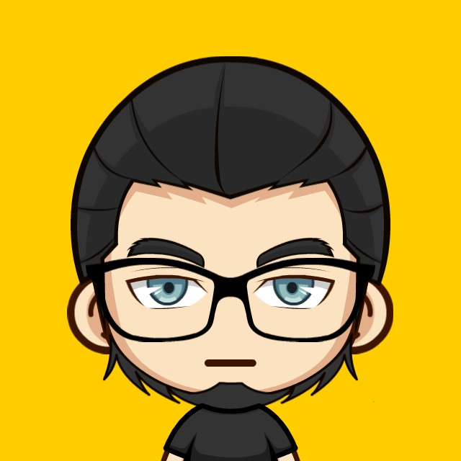
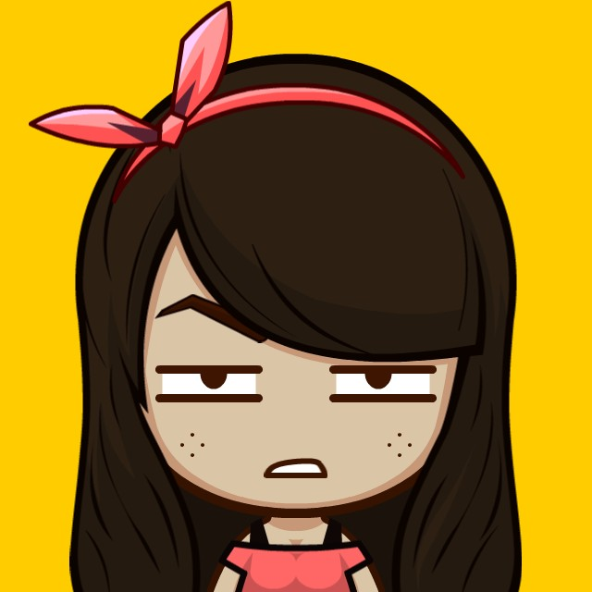
Iterative design process
Multiobjective optimization expert
2. Prototype
3. Feedback and update
4. Implementation
5. Feedback and update
1. Analyze requirements
6. All functionalities complete?
No
Cognition expert
Stop
Yes
Front-end developers
Back-end developers
Others
Notes:
This is general but we need to test it

Slide 11
Iterative design process
1. Analyze requirements:
Identify the functionalities that need to be incorporated in the system. For example:
Define new optimization problems
Optimization methods available
User-related functionalities
Workflow for each functionality
People involved:
2. Prototype
3. Feedback and update
4. Implementation
5. Feedback and update
1. Analyze requirements
6. All functionalities complete?
No
Stop
Yes

Slide 12
Iterative design process
2. Prototype
Improve the overall understanding of the design
Quick and easy iterative design with static UIs
Provide focused feedback
Accelerate the speed of design development, eliminating the need to make a large number of edits
People involved:
2. Prototype
3. Feedback and update
4. Implementation
5. Feedback and update
1. Analyze requirements
6. All functionalities complete?
No
Stop
Yes

Slide 13
Iterative design process
3. Feedback and update
Comments about the prototype mainly oriented to improve:
Workflow
Styles
People involved:
2. Prototype
3. Feedback and update
4. Implementation
5. Feedback and update
1. Analyze requirements
6. All functionalities complete?
No
Stop
Yes

Slide 14
Iterative design process
4. Implementation
Implement the latest version of the prototype considering the comments from the previous state
Test individual functionalities
Update back-end
People involved:
2. Prototype
3. Feedback and update
4. Implementation
5. Feedback and update
1. Analyze requirements
6. All functionalities complete?
No
Stop
Yes

Slide 15
Iterative design process
5. Feedback and update
Consists of reviewing the latest version of the implementation.
The second round of feedback allow us to validate the design decisions made in the prototype.
Update the implementation and the prototype based on the comments.
People involved:
2. Prototype
3. Feedback and update
4. Implementation
5. Feedback and update
1. Analyze requirements
6. All functionalities complete?
No
Stop
Yes

Slide 16
Iterative design process
If there are more functionalities to be implemented, we start a new iteration of the process.
When all the requirements have been addressed in the implementation, we stop the process but keep maintaining the code.
People involved
2. Prototype
3. Feedback and update
4. Implementation
5. Feedback and update
1. Analyze requirements
6. All functionalities complete?
No
Stop
Yes

Slide 17
GUIs in DESDEO

Slide 18
GUIs in DESDEO
desdeo-mcdm
desdeo-tools
desdeo-emo
desdeo-webapi
GUI and visualizations
desdeo-problem

Slide 19
GUIs in DESDEO
It utilizes desdeo-webapi to access the methods and optimization problems available in DESDEO
Multiple versions of the interface have been implemented, but the core idea is the same in all of them.
Currently UIs for the following multiobjective optimization methods have been implemented:
Reference point method​
NAUTILUS Navigator​
Synchronous NIMBUS
E-NAUTILUS

Slide 20
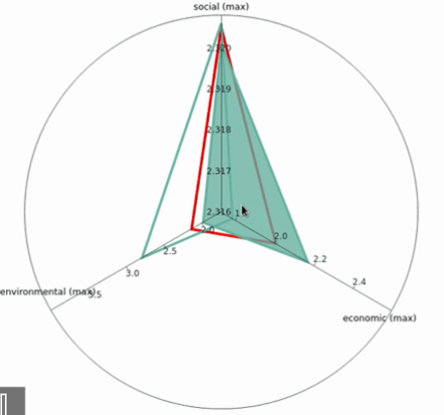
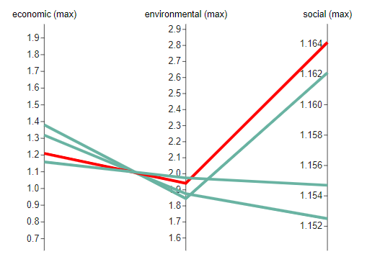
Visualizations
Multiple visualization components have been implemented in DESDEO:
Horizontal axis plot
Radar chart
Parallel coordinate plot
Navigation bar

Slide 21
Visual design guidelines
Color palette for the general UI
Identify a set of colors to represent the objective functions (check accessibility)
Reserved colors: selected solution, upper bound, lower bound, etc.
Icons to represent each action in the system
Typography
General layout

Slide 22
Future developments
A new version of the GUI will be released for the minimal viable producto (August)
New functionalities:
Archive of solutions
Guest users
Interactive evolutionary methods
More visualizations
And more …
You can contribute to DESDEO
DESDEO website: https://desdeo.it.jyu.fi GitHub: https://github.com/industrial-optimization-group

Slide 23
Multiobjective Optimization Group Website: http://www.mit.jyu.fi Email: optim@jyu.fi
Giomara Lárraga
giomara.g.larraga-maldonado@jyu.fi
This research has been funded by the Academy of Finland (grant 322221).
Notes:
Funded by the Academy of finland

