Slide 1
Latest Advancements in a New Paradigm in Interactive Multiobjective Optimization
Bhupinder Singh Saini,
Multiobjective Optimization Group
University of Jyväskylä

Slide 2
Contents
Introduction to IOPIS
Multiobjective Optimization
Scalarization functions
Preference Incorporated Space
The IOPIS algorithm
IOPIS variants
IOPIS/GLIDE
MultiDM/IOPIS
The future of IOPIS
Conclusions

Slide 3
Introduction

Slide 4
Multiobjective Optimization
Minimization of multiple objectives
Trade-offs between many Pareto optimal solutions
Evolutionary Algorithms (EAs): Population based optimizers
Exponentially difficult to solve with increasing number of objectives

Slide 5
Scalarization Functions
Convert a multiobjective problem into a single objective problem
Incorporate decision maker’s preference
Many different kinds
Interpret the same decision maker’s preference differently
GLIDE-II: Parameterized generation of scalarization functions
Ruiz, F., Luque, M. & Miettinen, K. Improving the computational efficiency in a global formulation (GLIDE) for interactive multiobjective optimization. Ann Oper Res 197, 47–70 (2012).

Slide 6
GUESS scalarization function
Uses reference point preference
“Give me solutions like ”
Ruiz, F., Luque, M. & Miettinen, K. Improving the computational efficiency in a global formulation (GLIDE) for interactive multiobjective optimization. Ann Oper Res 197, 47–70 (2012).

Slide 7
STOM scalarization function
Uses reference point preference
“Give me solutions like ”
Ruiz, F., Luque, M. & Miettinen, K. Improving the computational efficiency in a global formulation (GLIDE) for interactive multiobjective optimization. Ann Oper Res 197, 47–70 (2012).

Slide 8
NIMBUS scalarization function
Uses classification preference
Preference given in comparison to a current solution
“Give me solutions with better ”
“Don’t make worse than ”
Ruiz, F., Luque, M. & Miettinen, K. Improving the computational efficiency in a global formulation (GLIDE) for interactive multiobjective optimization. Ann Oper Res 197, 47–70 (2012).

Slide 9
What happens if multiple scalarizing functions are used together to convert the original MOP into a new MOP?

Slide 10
Preference Incorporated Space (PIS)
Form a new space using q scalarization functions
Optimize in this new space using any appropriate EA
Saini, B. S., Hakanen, J., & Miettinen, K. (2020). A New Paradigm in Interactive Evolutionary Multiobjective Optimization. In International Conference on Parallel Problem Solving from Nature (pp. 243-256). Springer.

Slide 11
Preference Incorporated Space (PIS)

Slide 12
IOPIS Algorithm
Preference elicitation
PIS creation
Display solutions from final EA population
Optimization in the PIS with EA
Saini, B. S., Hakanen, J., & Miettinen, K. (2020). A New Paradigm in Interactive Evolutionary Multiobjective Optimization. In International Conference on Parallel Problem Solving from Nature (pp. 243-256). Springer.

Slide 13
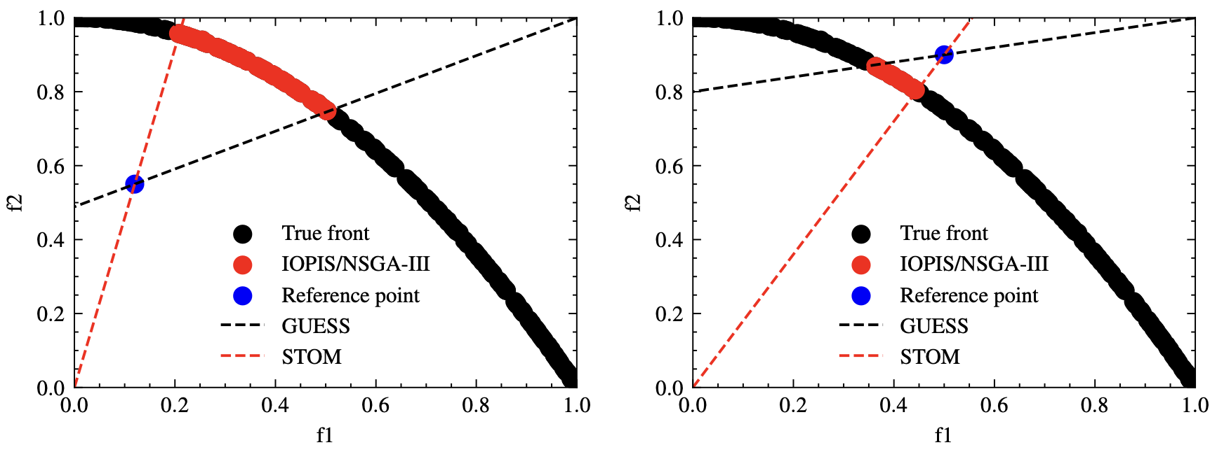
IOPIS Algorithm
Solutions obtained with IOPIS/NSGA-III for the ZDT2 problem

Slide 14
IOPIS properties
Control over the number of dimensions
Make any (no preference) EA interactive
Guaranteed to find preferred and Pareto optimal solutions for any preference
The front collapses to a single point in certain situations.

Slide 15
IOPIS Variants

Slide 16
IOPIS/GLIDE
Add support for many more scalarization functions!
Incorporates the GLIDE-II framework into IOPIS.
Enables using many different kinds of scalarization functions
Lets the DM provide preferences in different formats.
Ruiz, F., Luque, M. & Miettinen, K. Improving the computational efficiency in a global formulation (GLIDE) for interactive multiobjective optimization. Ann Oper Res 197, 47–70 (2012).

Slide 17
MultiDM/IOPIS
Provide different preferences to the scalarization functions forming the PIS!
Same guarantees as the original IOPIS algorithm. Moreover…
Enables multiple DMs to provide preferences interactively.​
Number of dimensions for optimization = number of DMs.​
Support multiple DMs using any EA.
The DMs can give preferences in different formats (if different scalarization functions are used to create the PIS).
Saini, B.S., Chakrabarti, D., Chakraborti, N., Shavazipour, B., Miettinen, K., Interactive Data-driven Multiobjective Optimization of Metallurgical Properties of Microalloyed Steels using the DESDEO Framework, Engineering Applications of Artificial Intelligence, 120, article 105918, 2023.​

Slide 18
The Future of IOPIS

Slide 19
Some open questions
How to choose scalarization functions to build the PIS?
How to change the set of scalarization functions if DM is not happy with the distribution of solutions?
How to avoid cases of the Pareto front from IOPIS collapsing to a single point?

Slide 20
A new IOPIS algorithm
Let’s create a version of IOPIS that finds all “preferred” solutions.
Pareto optimal solutions that either dominate or are dominated by the current preference.
A “super-set” of the original IOPIS algorithm
The number of scalarization functions needed for this is the same as the number of objectives.
Allows us to dynamically change the number of scalarization functions when needed.

Slide 21
A new IOPIS algorithm: An example
Start with the default IOPIS algorithm.
Add additional scalarization functions, for example, when DM asks for more diversity.
Scalarization functions can be chosen to provide diversity along chosen directions.
In the extreme case, the PIS will return ALL Pareto optimal and preferable solutions.

Slide 22
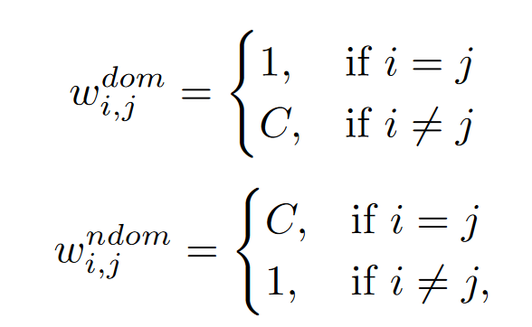
A new IOPIS algorithm: Additional scalarizing functions
, for i in 1…k.
Use if a solution dominating the reference point has been found.
Use if a solution dominating the reference point has not been found.
C is a large real number.

Slide 23
Conclusions
The IOPIS algorithm brings forth a new paradigm in interactive evolutionary multiobjective optimization.
Provides a modular way to incorporate preferences of one or more DMs.
Provides new ways to tackle important challenges, e.g., group decision making.
Creating new variants of IOPIS is trivial with DESDEO.
We have developed a new variant that lets us dynamically adjust the PIS to fit the DM needs.
But many directions of future research remain open…

Slide 24
Even more open questions
How to build a user interface for IOPIS:
Include different scalarization function options
Include many evolutionary algorithms options
Include different ways of providing preferences
Support multiple DMs?
How can surrogate models be used effectively with IOPIS in challenging problems?
How to provide explanations about the solutions found by IOPIS?
And many more..

Slide 25
Thank you!
Funded by The Academy of Finland
DESDEO
An open-source framework for interactively solving multiobjective optimization problems
desdeo.it.jyu.fi
DEMO thematic research area
jyu.fi/demo

